Slide 1

Geometry
Unit 2, Lesson 6 “All” and “Not” Statements Volume 1, pg. 106

Slide 2


Benchmark
MA.912.LT.4.3
Identify and accurately interpret “if…then,” “if and only if,” “all” and “not” statements. Find the converse, inverse, and contrapositive of a statement.
volume 1, pg. 106

Slide 3
Integrated Mathematical Thinking and Reasoning Standards
MA.K12.MTR.1.1 Actively participate in effortful learning both individually and collectively.
MA.K12.MTR.4.1 Engage in discussions that reflect on the mathematical thinking of self and others.
MA.K12.MTR.5.1 Use patterns and structure to help understand and connect mathematical concepts.
MA.K12.MTR.6.1 Assess the reasonableness of solutions.
volume 1, pg. 106

Slide 4

Learning Targets
I can write and interpret an “all” statement.
I can write and interpret a negation.
volume 1, pg. 106

Slide 5

Warm-Up
volume 1, pg. 107

Slide 6
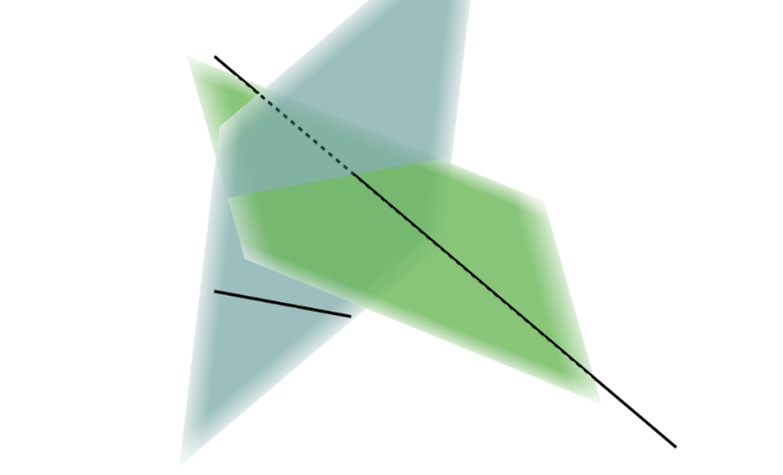
2.6.1 Warm-Up: Bell Work
Complete the table for the conditional statement.
If two lines are skew, then the
lines do not lie on the same
plane.
volume 1, pg. 107

Slide 7
Relationship to Conditional | Statement | True or False
Converse
Inverse
Contrapositive
If the conditional statement is biconditional, then write it as a biconditional. If the conditional statement is not biconditional, then explain why not.
volume 1, pg. 107

Slide 8

Guided Instruction
volume 1, pg. 107

Slide 9
2.6.2 Guided Instruction: “All” and “Not” Statements
Mathematical statements may not be conditional or biconditional. Mathematical statements could be written using “all.” The statement must be universally true to use the word “all.”
Discuss with your partner if the statement, “All quadrilaterals have four sides” is universally true. Summarize your discussion.
Rewrite “All quadrilaterals have four sides” as an if-then statement.
Discuss with your partner why the statement “Some quadrilaterals have four sides” is not true. Summarize your discussion.
volume 1, pg. 107

Slide 10
Determine if each statement is true.
Rewrite each false statement using “some.”
Statement | True or False
All dogs are Labradors.
All polygons have congruent sides.
All cats are mammals.
volume 1, pg. 108

Slide 11

Write each statement as an if-then statement.
It may be helpful to understand “all” statements using Venn diagrams.
Statement | If-Then
All dogs are Labradors.
All polygons have congruent sides.
All cats are mammals.
A Venn diagram is a diagram representing mathematical or logical sets pictorially as circles. Common elements of the sets are within the overlap of the circles.
volume 1, pg. 108

Slide 12
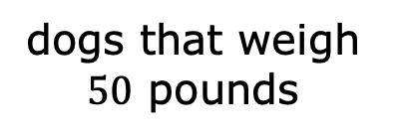

The Venn diagram and a statement are shown.
All parrots are birds.
Some dogs weigh 50 pounds.
Discuss with your partner how the Venn diagrams help to show the difference between “all” and “some.” Summarize your discussion.
birds
parrots
dogs that weigh $50$ pounds
dogs
things that weigh $50$ pounds
volume 1, pg. 108

Slide 13
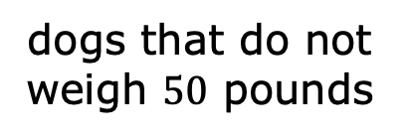
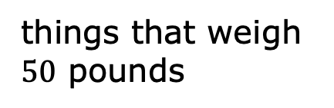

The Venn diagram below shows where dogs that do not weigh $50$ pounds would be placed.
Write a statement that matches the Venn diagram.
dogs that do not weigh $50$ pounds
dogs
things that weigh $50$ pounds
volume 1, pg. 109

Slide 14

The negation of a statement is the opposite of the statement. If the statement is true, then the negation must be false.
Use the definition of negation to write the negation of each statement.
Today is Wednesday.
Seo-jun is not wearing blue.
volume 1, pg. 109

Slide 15
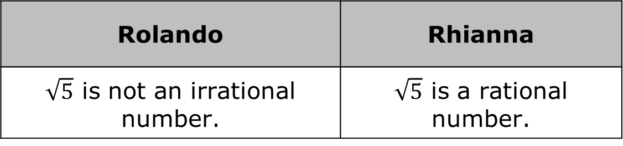
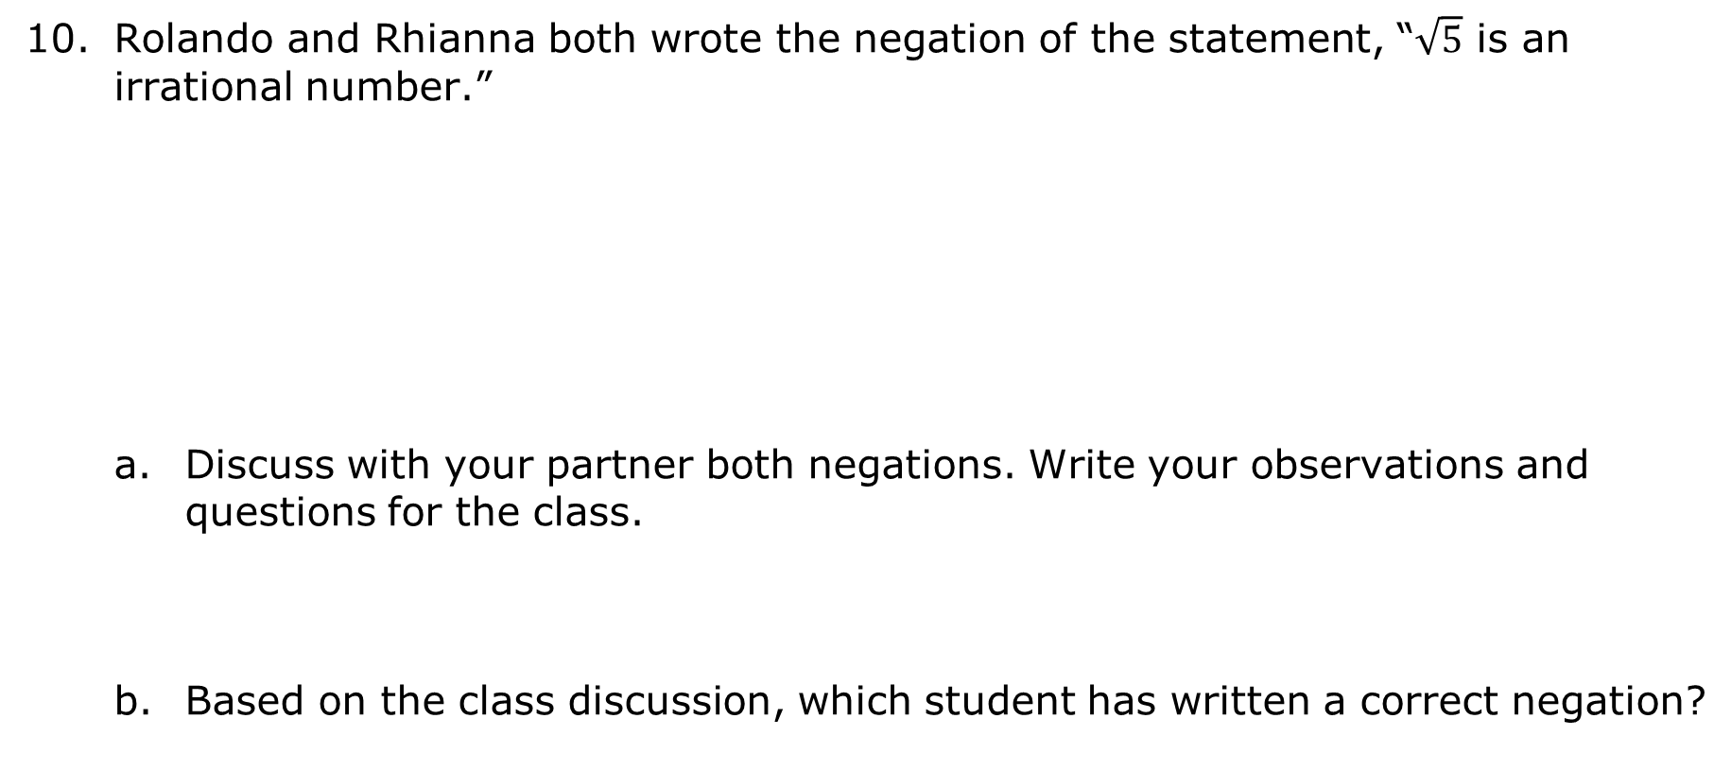
Rolando and Rhianna both wrote the negation of the statement, “$\sqrt{5}$ is an irrational number.”
Discuss with your partner both negations. Write your observations and questions for the class.
Based on the class discussion, which student has written a correct negation?
Rolando | Rhianna
$\sqrt{5}$ is not an irrational number. | $\sqrt{5}$ is a rational number.
volume 1, pg. 109

Slide 16

Guided Practice
volume 1, pg. 110

Slide 17

2.6.3 Guided Practice: “All” Statements and Negation
Determine if each statement is true.
Rewrite each false statement using “some.”
Statement | True or False
All congruent angles have the same measure.
All odd numbers are prime.
All points that lie in a plane are collinear.
volume 1, pg. 110

Slide 18
Write each statement as an if-then statement.
Statement | If-Then
All congruent angles have the same measure.
All odd numbers are prime.
All points that lie on a plane are collinear.
volume 1, pg. 110

Slide 19
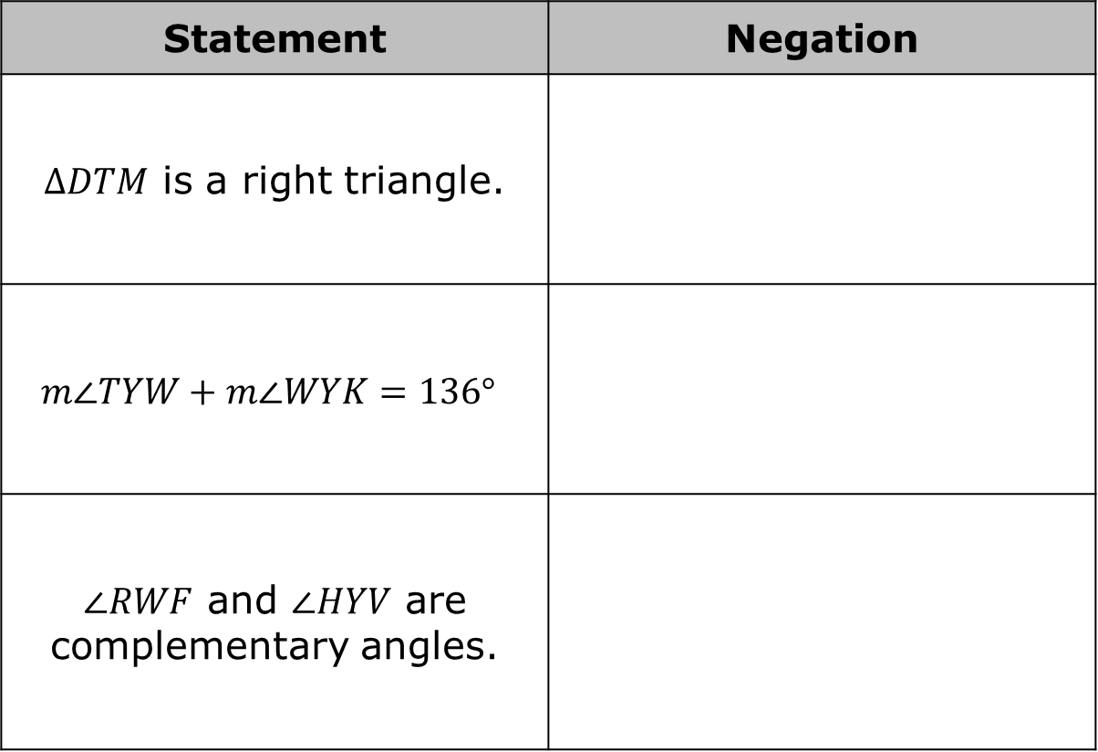
Write the negation of each statement.
Statement | Negation
$∆DTM$ is a right triangle.
$$m∠TYW+m∠WYK=136°$$
$∠RWF$ and $∠HYV$ are complementary angles.
volume 1, pg. 110

Slide 20

Wrap-Up
volume 1, pg. 111

Slide 21



2.6.4 Wrap-Up: Reflection
Circle the icon that best describes your understanding of each concept below.
I need help. I got it. I could help someone.
I can write the converse of a mathematical statement.
I can write the inverse of a mathematical statement.
I can write the contrapositive of a mathematical statement.
I can determine if a statement is biconditional.
I can write and interpret an “all” statement.
I can write and interpret a negation.
volume 1, pg. 111

